Slide 1

Lab 3b – Observer - Behavioral Design Pattern
INSPIRING CREATIVE AND INNOVATIVE MINDS

Slide 2
Observer
Intent
  Define a one-to-many dependency between objects so that when one object changes state, all its dependents are notified and updated automatically
Applicability
  When an abstraction has two aspects, one dependent on the other
  When a change to one object requires changing others, and you don't know how many objects need to be changed
  When an object should notify other objects without making assumptions about who these objects are
© E. Gamma, R. Helm, R. Johnson, J. Vlissides and Addison-Wesley

Slide 3
Observer
Consequences
  Modularity: subject and observers may vary independently
  Extensibility: can define and add any number of observers
  Customizability: different observers provide different views of subject
  Unexpected updates: observers don't know about each other
  Update overhead: might need hints
Implementation
  Subject-observer mapping
  Dangling references
  Avoiding observer-specific update protocols: the push and push/pull models
  Registering modifications of interest explicitly
© E. Gamma, R. Helm, R. Johnson, J. Vlissides and Addison-Wesley

Slide 4
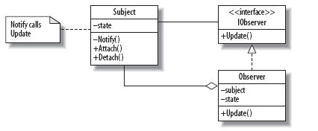
Observer - Design

Slide 5
Observer - Design
Subject
  The class whose instances independently change their state and notify Observers
IObserver
  An interface for Observers specifying how they should be updated
Observer
  A class that provides an Update method to enable its instance’s state to stay consistent with the Subject’s
Update
  The operation that forms the interface between the Subject and the Observers
Notify
  The event mechanism for calling the Update operation on all Observers

Slide 6
Observer – Implementation
Youtube Videos https://www.youtube.com/watch?v=98DiwRp-KZk&ab_channel=Telusko

